Slide 1
Semi Final Results
Zero-sum stochastic game

Slide 2
Table of contents
What did we build?
Game Environment
Algorithms
Agents
Game Scenarios
Game Evaluation

Slide 3
Research goal
Build the agent who will excel in the game of light against zombies.

Slide 4

The environment
Reward function
Since we play a two sum game, the reward of the agents is symmetric
The zombie agent receives positive reward of 1 for every zombie that reached the end safely
State space
For the zombie agent, the state consists of zombies positions across the board
The light agent receives the positions as well as the zombies’ strength

Slide 5


Action Space - $N×N$ board
Let us consider a Therefor, the zombie player is able to choose among the $N$start position for a zombie on the left side of the board*
In contrast, the light player can choose any location on the board which adds up to $N×N$ possibilities
Wherever the light is placed, the zombies beneath it absorbs certain amount of damage
For every zombie that reaches the end of the grid, we decide if it will survive based on its current hit points

Slide 6
The code
Building an environment that is able to communicate with an interface of generic type of any agent, turned to be an integrated and significant part of the project:
More than 20 classes and interfaces
Four simple agents
Three algorithms from different domains (Reinforcement Learning and Tree Search)
Before we diving deep into all the gameplay-scenarios, lets review the platform we have built to handle the project demands

Slide 7
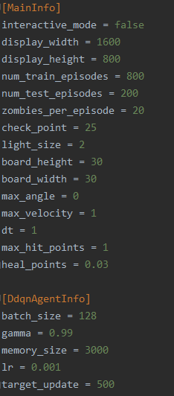
The code
To be able to run the project, we first must define our desired configurations:
The environment: and the learning agent:

Slide 8
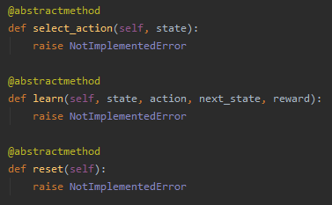
The code
Next, we have to define the minds behind the competitors:
For example, we want to let the Double Deep Q-Learning agent play as the light player against a zombie player that acts according the uniform distribution
Each agent must implement some basic methods in order to participate the game:

Slide 9
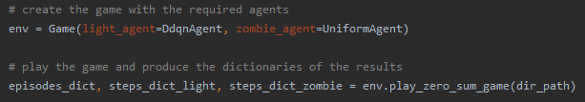
The code
Finally, we are able to run the environment with the agents we have built:
After the scenario ends, we are able to process the results – In a few slides ☺

Slide 10
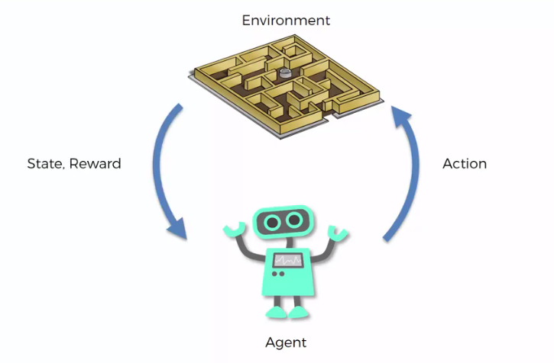


The code - summery
Preparations
1. Define agents and implement by generic interface
2. Add configuration of agents and environment
Main Process
3. Run the game with two agents as light and zombie players
LIGHT
ZOMBIE

Slide 11
video

Slide 12

Games and agents
Game Boards: $10×10, 20×20, 30×30$
Simple Agents:
Single Action
Double Action
Uniform
Gaussian
Learning Agent:
Double Deep Q-Learning

Slide 13
Simple Agents elaboration

Slide 14
Game config
Fixed Parameters:
Number of training episodes: 800
Number of test episodes: 200
Zombies per episode: 20
Light size: 2*
Minimum hit points of certain death: 1
Heal ratio: 0.97
Tuning Parameters:
Target Policy update frequency – [500, 750, 1000]
Replay Memory size – [3000, 4000, 5000]

Slide 15
game scenarios
Zombie Player | Light Player | Game Board
Single Action | DDQN | 10x10
Double Action
Uniform
Gaussian
Single Action | DDQN | 20x20
Double Action
Uniform
Gaussian
Single Action | DDQN | 30x30
Double Action
Uniform
Gaussian
Zombie Player | Light Player | Game Board
DDQN | Single Action | 10x10
 | Double Action
 | Uniform
 | Gaussian
DDQN | Single Action | 20x20
 | Double Action
 | Uniform
 | Gaussian
DDQN | Single Action | 30x30
 | Double Action
 | Uniform
 | Gaussian

Slide 16
Double deep q-learning evaluation
To estimate the success of a learning DDQN agent, we will use average test score.
Since we are using epsilon greedy strategy, the known ‘Time to Convergence’ indicator is redundant
Later on, we are going to choose the best sets of parameters and look at the action distributions of the players in the chosen games
At last, we are going to compare the results of the best agent over the different competitors

Slide 17
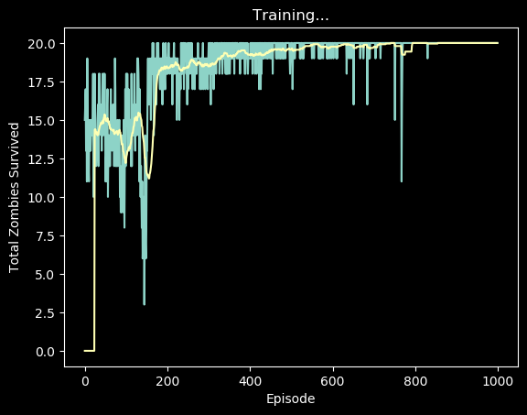
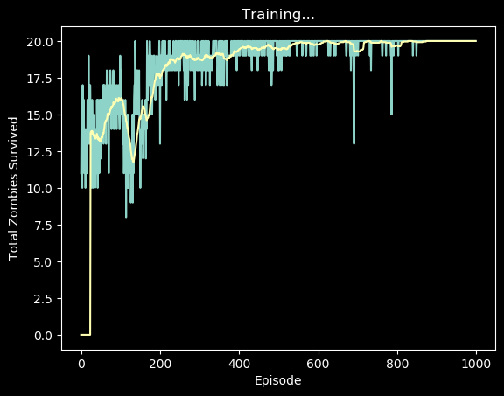

Example of a single evaluation
Sum, Avg
$$−>$$
19.99

Slide 18
DDQN as the zombie player
Goal – Maximize Total Reward

Slide 19
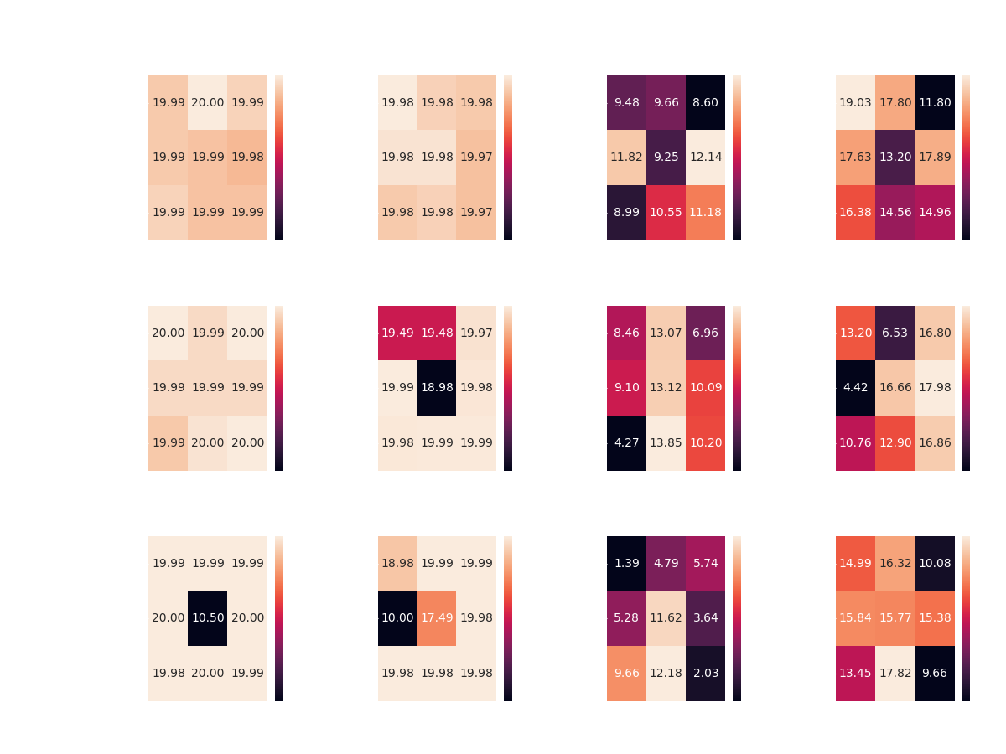
DDQN agent vs. Single Action agent
Board of 10x10
Goal: Maximize Total Reward (Minimum zombies survival)

Slide 20
DDQN vs. all Simple Agents – board of 10x10

Slide 21
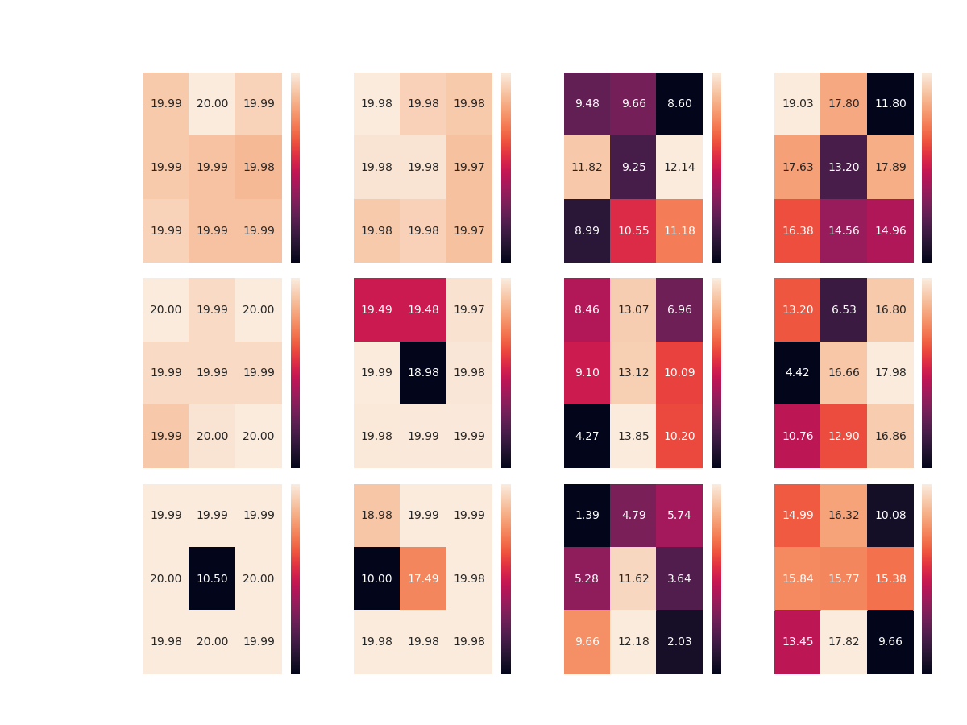

Slide 22
Results Discussion
Overall, it seems that the DDQN agent manages to overcome its competitors in most of the scenarios:
Achieving optimal reward competing Single and Double Action Agents with most of the configurations, on top all boards
Achieving 17+ average reward competing the Gaussian Agent on all boards, without achieving optimal reward in any scenario
However, the DDQN agent seems to encounter difficulties when faced with the Uniform Agent – managing to achieve average reward of 12-14

Slide 23
Results Discussion
While Competing against both the Random Agents, the DDQN Agent gets approximately same average reward over all three boards
Perhaps more learning episodes would make a change here?
Keep in mind that the highest reward against the Uniform Agent as light player is 15 – calculated by an agent which picks the best action exclusively (places zombies at the first row)
To settle the issue, I ran multiple scenarios of the same configuration, DDQN Agent vs. Uniform Agent, this time with 1800 learning episodes and 200 test episodes – all cases yield to the same average test reward of around 12

Slide 24
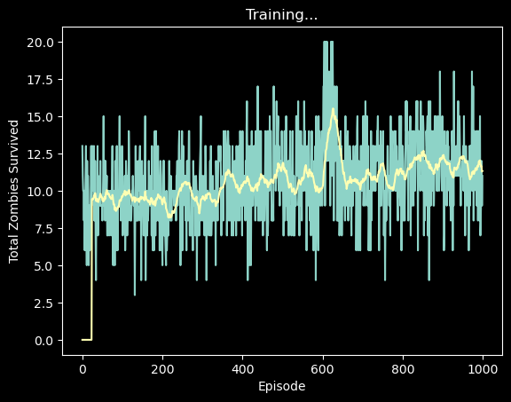
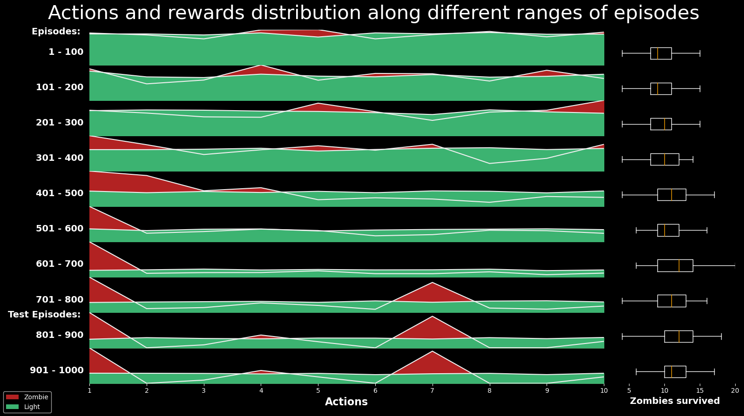

DDQN Agent vs. Uniform Agent - $10×10$ board
Lets review the rewards the agents get along the episodes in the scenario of DDQN Agent vs. Uniform Agent…
Both graphs indicate that the agent played according the optimal policy for a small period of episodes (600-700)

Slide 25
DDQN plays zombie - Best configurations*
Average Test Reward | Target update | Memory size | competitor
~19.99 | 750 | 5000 | Single Action | Board 10x10
~19.99 | 750 | 5000 | Double Action
12.14 | 1000 | 4000 | Uniform
10.55 | 750 | 5000 | Gaussian
~19.99 | 750 | 5000 | Single Action | Board 20x20
~19.99 | 750 | 5000 | Double Action
13.85 | 750 | 5000 | Uniform
17.98 | 1000 | 4000 | Gaussian
~19.99 | 750 | 5000 | Single Action | Board 30x30
~19.99 | 750 | 5000 | Double Action
12.18 | 750 | 5000 | Uniform
17.82 | 750 | 5000 | Gaussian

Slide 26
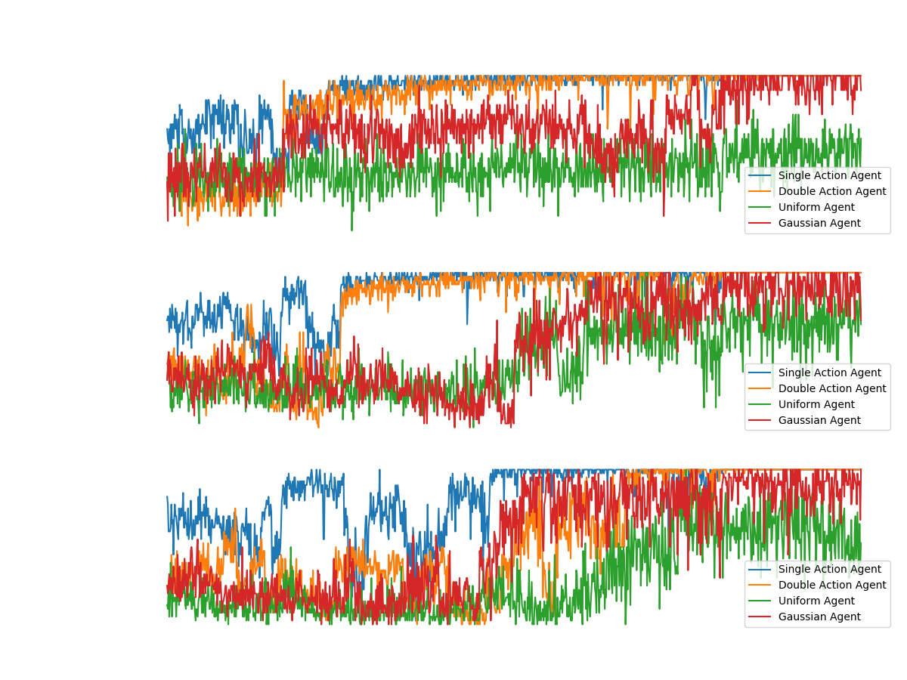

Slide 27
DDQN as the light player
Goal – Maximize Total Reward – Minimize Zombies survive

Slide 28
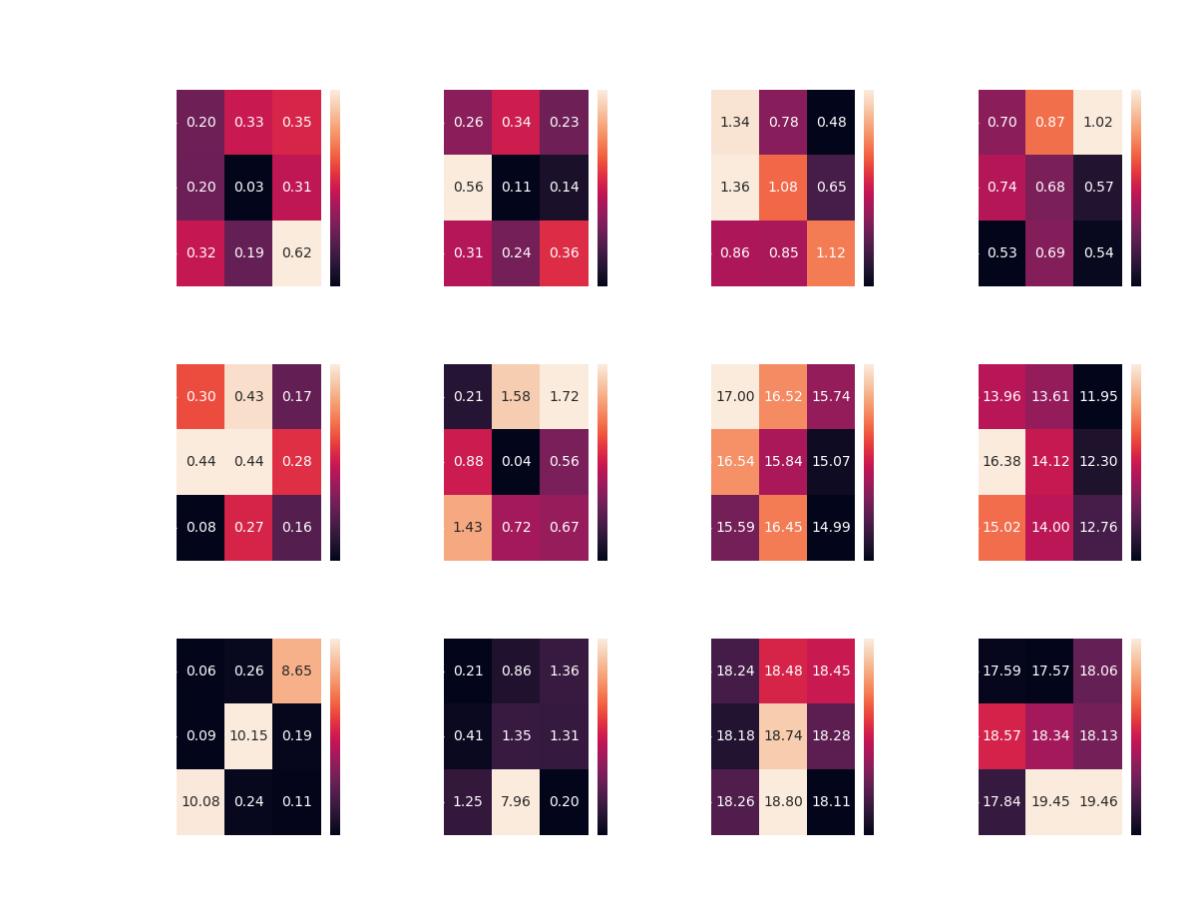
DDQN agent vs. Single action agent
Board of 10x10
Goal: Maximize Total Reward (Minimum zombies survival)
Notes:
We keep showing the rewards of the zombie player – the goal of the light is to minimize it.

Slide 29
DDQN vs. all – board of 10x10

Slide 30
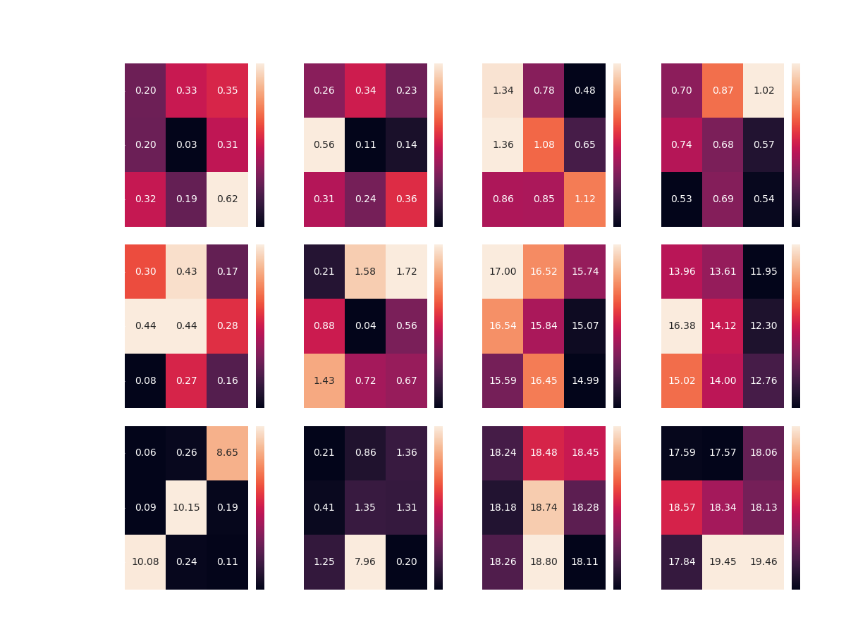

Slide 31
Results Discussion
This time the DDQN Agent managed to achieve partial success.
Over all boards, the DDQN Agent seems to overcome the two Constant Agents
With some preference of the [750, 4000] configuration in half of the cases
However, competing the Random Agents didn’t lead to same success
The DDQN Agent was able to reach optimality only in the case of the smallest board
This time, without any preference of any specific configuration

Slide 32
DDQN plays light - Best configurations
 | Competitor | Memory size | Target update | Average Test Reward
Board 10x10 | Single Action | 4000 | 750 | 0.03-
 | Double Action | 4000 | 750 | 0.11-
 | Uniform | 3000 | 1000 | 0.48-
 | Gaussian | 5000 | 500 | 0.53-
Board 20x20 | Single Action | 5000 | 500 | 0.08-
 | Double Action | 4000 | 750 | 0.04-
 | Uniform | 5000 | 1000 | 14.99-
 | Gaussian | 3000 | 1000 | 11.94-
Board 30x30 | Single Action | 3000 | 500 | 0.06-
 | Double Action | 5000 | 1000 | 0.2-
 | Uniform | 5000 | 1000 | 18.11-
 | Gaussian | 3000 | 750 | 17.57-

Slide 33
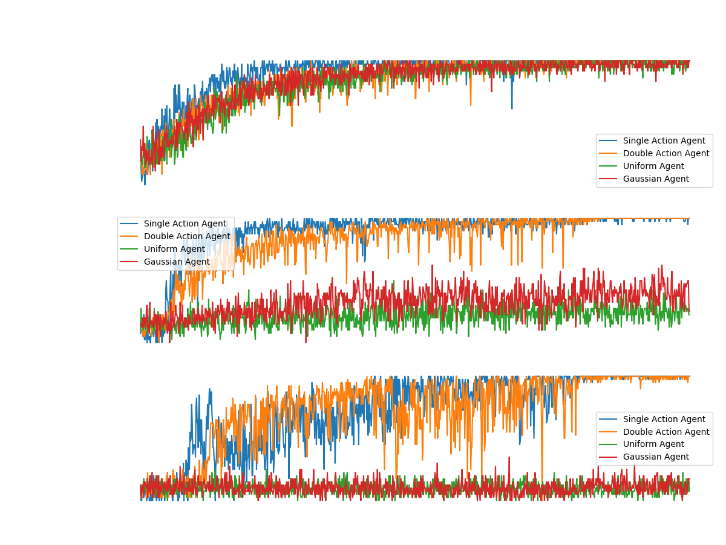

Slide 34
Do-do’s
Plot moving average instead of real results (new graphs)
Extract graphs of partial labels for build up
Update the sns graph of the light agent
Add the graphs of the comparison
Elaborate on the simple agents
Ask Yehudit:
Add a slide to scenarios and elaborate on the tuning params?
Add action distribution graphs of best agents?

